Slide 1
CREDIT EDA CASE STUDY
BY- SWAGAT SAHOO
PANDIARANJAN GANAPATHYSAMY

Slide 2
PROBLEM STATEMENT :
This case study is to find out what categories the bank should provide loan to.
To check :
What are the categories who are defaulters and who are not.
Which category of people face issues while repaying the loan and which categories don’t face any issues.
On which categories bank should focus more for providing loans.
There are two types of errors :
Applicant is likely to repay loans but loan providing company rejects the application
Applicant is not likely to repay but loan providing company approves the loan
These errors are need to be taken care of so that the loan providing company doesn’t incur any loss.

Slide 3
APPLICATION DATA
Application Data frame is created using file Application_data.csv.
Shape, info, columns were checked.
Missing values for each columns were checked. Columns with more than 30% missing values were removed as they won’t be of any use.
Columns with less number of missing values were checked. Then checked if there is any outliers in that column. If outlier is present then missing values were replaced with median value.
Rows with missing values were also checked and handled.
Unwanted rows which are not useful for analysis were checked and removed from the dataset.

Slide 4
APPLICATION DATA
Application Data frame is created using file Application_data.csv.
Shape, info, columns were checked.
Missing values for each columns were checked. Columns with more than 30% missing values were removed as they won’t be of any use.
Columns with less number of missing values were checked. Then checked if there is any outliers in that column. If outlier is present then missing values were replaced with median value.
Rows with missing values were also checked and handled.
Unwanted rows which are not useful for analysis were checked and removed from the dataset.

Slide 5
APPLICATION DATA
Columns with missing values like ‘XNA’, ‘NAN, were checked and handled.
Column data types were checked and appropriate columns were converted to numeric.
A new ‘AGE’ column is created by dividing the ‘DAYS_BIRTH’ column by 365 and taking round of it.
Bins created for continuous variable categories column 'AMT_INCOME_TOTAL' , 'AMT_CREDIT' and 'AGE’.
Dataset is divided into two categories i.e
target=1(client with payment difficulties)
target=0(all others)

Slide 6
Categorical Univariate analysis for target-0

Slide 7
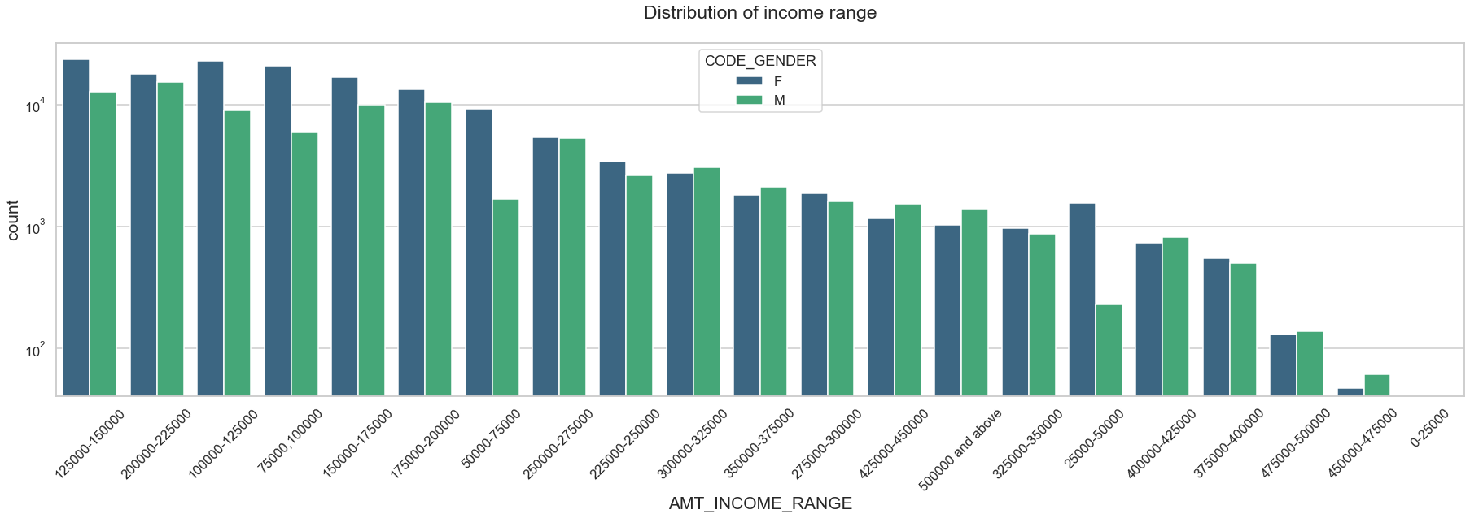
Distribution of Income range
Points to be concluded from the graph above :
Income range from 75000 to 200000 is having more number of credits.
For this range Females are having more credits than males.
female counts are higher than males in overall.
Very less count is coming from the income range 37500 to 500000.

Slide 8
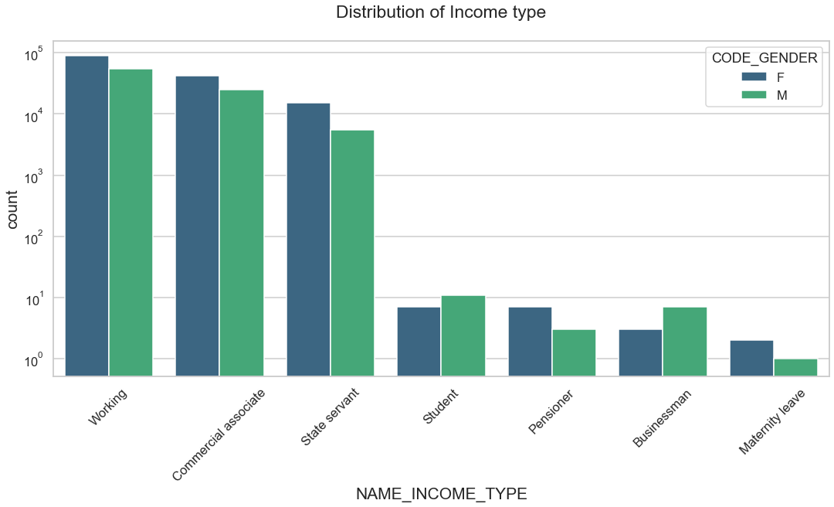
Distribution of income type
From the graph we can conclude that :
For income type "Working", "Commercial associates" and "State servant" the number of Credit counts are higher than others.
And for these three above mentioned groups Females are having more number of Credits count than Males.
Less number of Credits count are coming from "Student", "Businessman", "Pensioner", "Maternity leave"

Slide 9
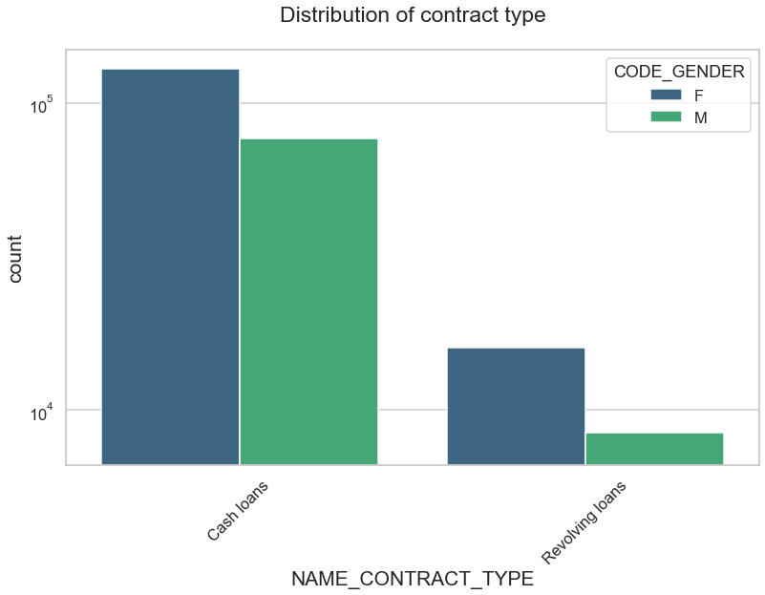
Distribution of contract type
From the graph we can conclude that :
For contract type "Cash loans" is having higher number of credits than contract type "Revolving loans"
Female category is leading for applying credits for this .

Slide 10
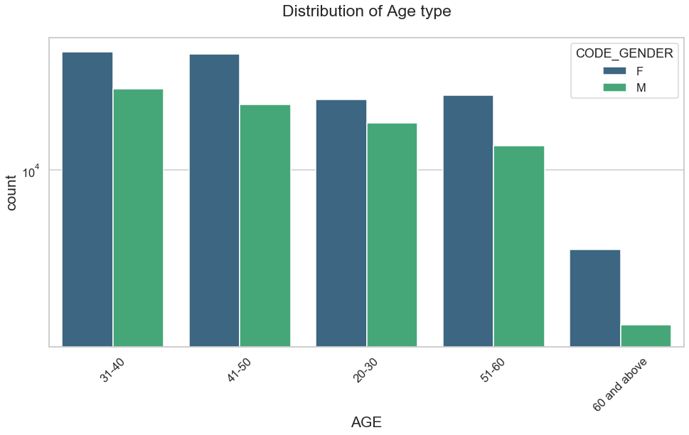
Distribution of Age Type
From the graph we can conclude that :
People between 20 to 60 are having more number of credits.
Number of females are greater than the number of males.

Slide 11
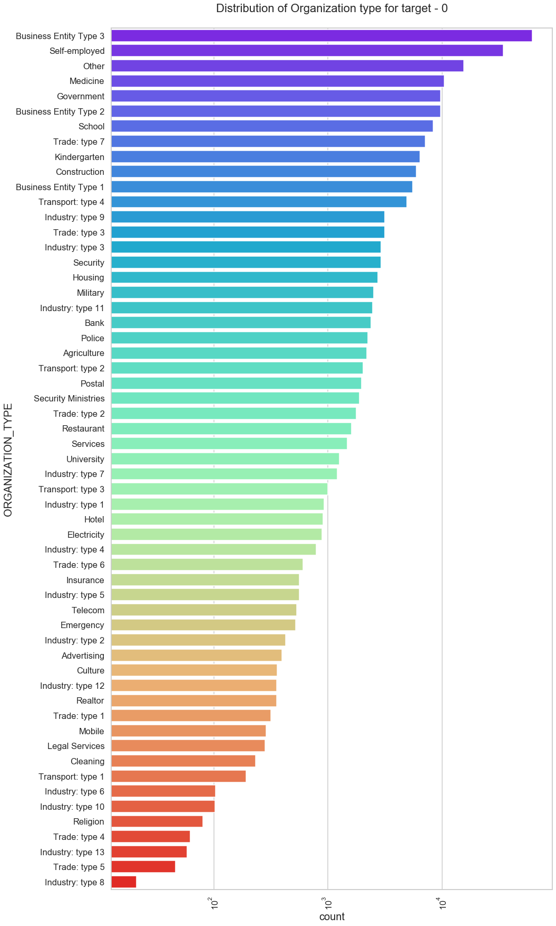
Distribution of organization type
From The graph we can conclude that :
Most of the clients who have applied for credits are from "Business Entity Type 3", "Self-employed", "Other", "Medicine", "Government", "Business Entity Type 2"
less number of clients are from "Industry: type 6", "Industry: type 10", "Religion", "Trade: type 4", "Industry: type 13", "Trade: type 5", "Industry: type 8"

Slide 12
Categorical Univariate analysis for target-1

Slide 13
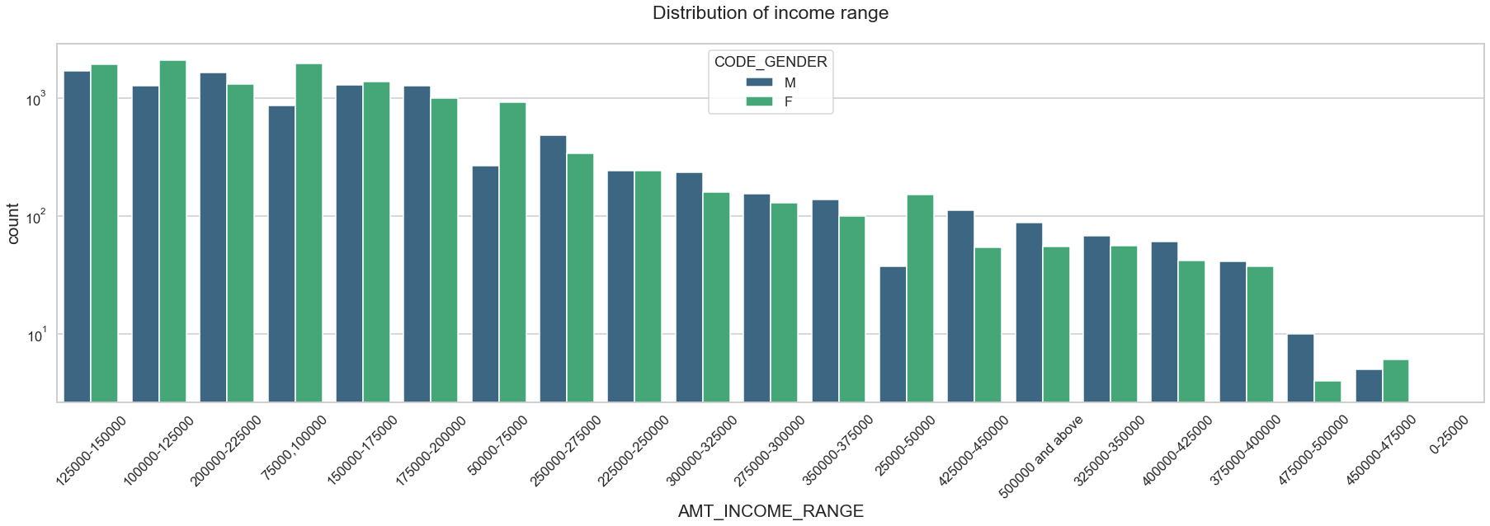
Distribution of Income range
From the above graph we can conclude that :
Income range from 75000 to 225000 is having more number of credits.
For this range female category is having more number of credits than male category.
Very less count os coming from the income range 375000 and above.
Overall female count is higher than the male count.

Slide 14
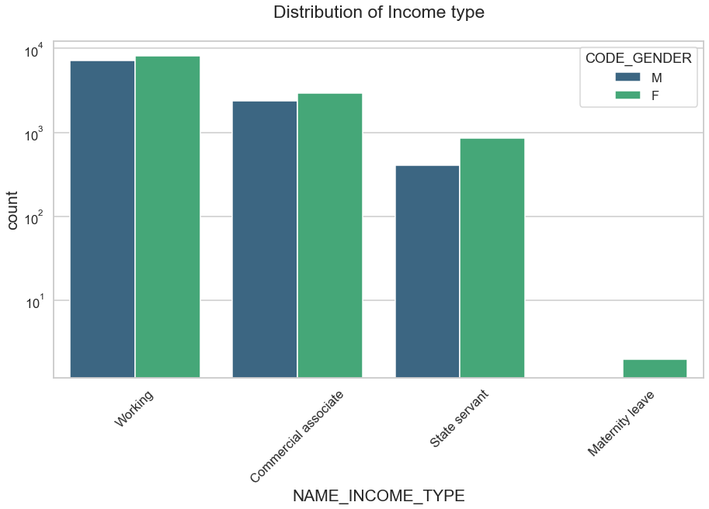
Distribution of income type
From the graph we can conclude that :
Income type "Working", "Commercial associate", "State servant" are having more number of credits than "maternity Leave".
Females are having more number of credits than males.
for Target_1 : There is no income type for ‘student’ , ’pensioner’ and ‘Businessman’ which means they don’t do any late payments.

Slide 15
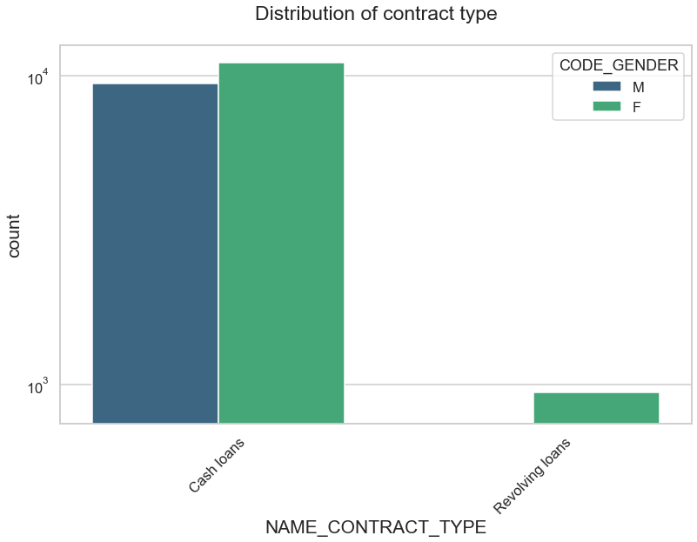
Distribution for contract type
From the graph we can conclude that :
For contract type ‘cash loans’ is having higher number of credits than ‘Revolving loans’ contract type.
For this also Female is leading for applying credits.
For target_1 : there is only Female Revolving loans.

Slide 16
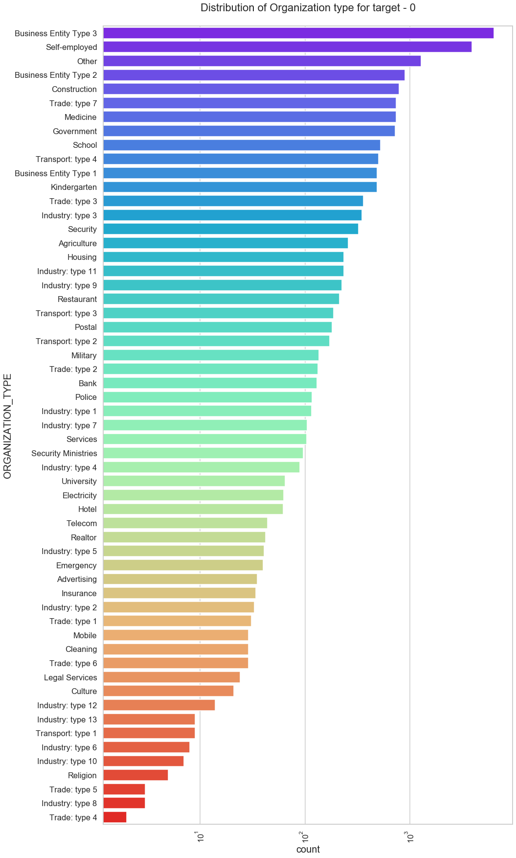
Distribution of organization type
From the graph we can conclude that :
Clients which have applied for credits are from most of the organization type ‘Business entity Type 3’ , ‘Self employed’ , ‘Other’ , ‘Medicine’ and ‘Government’.
Less clients are from Industry type 8,type 6, type 10, religion and trade type 5, type 4.
Same as type 0 in distribution of organization type.

Slide 17
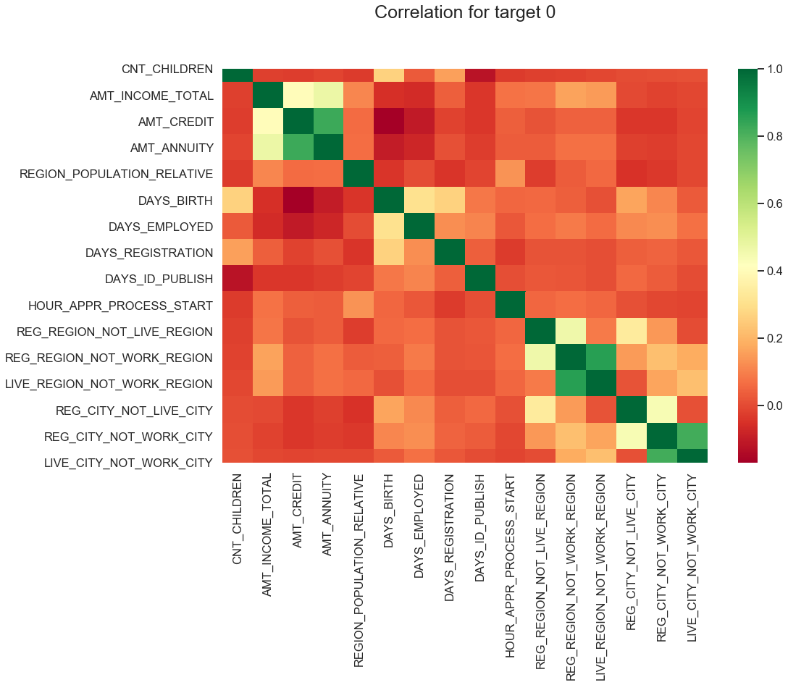
Correlation Of Target-0

Slide 18
Correlation For target 0
From the above correlation heat map we can conclude that :
Credit amount is inversely proportional to the date of birth, which means Credit amount is higher for low age and vice-versa.
Income amount is inversely proportional to the number of children client have, means more income for less children client have and vice-versa.
Credit amount is inversely proportional to the number of children client have, means Credit amount is higher for less children count client have and vice-versa.
clients have less children in densely populated area.
Credit amount is higher to densely populated area.
The income is also higher in densely populated area.

Slide 19
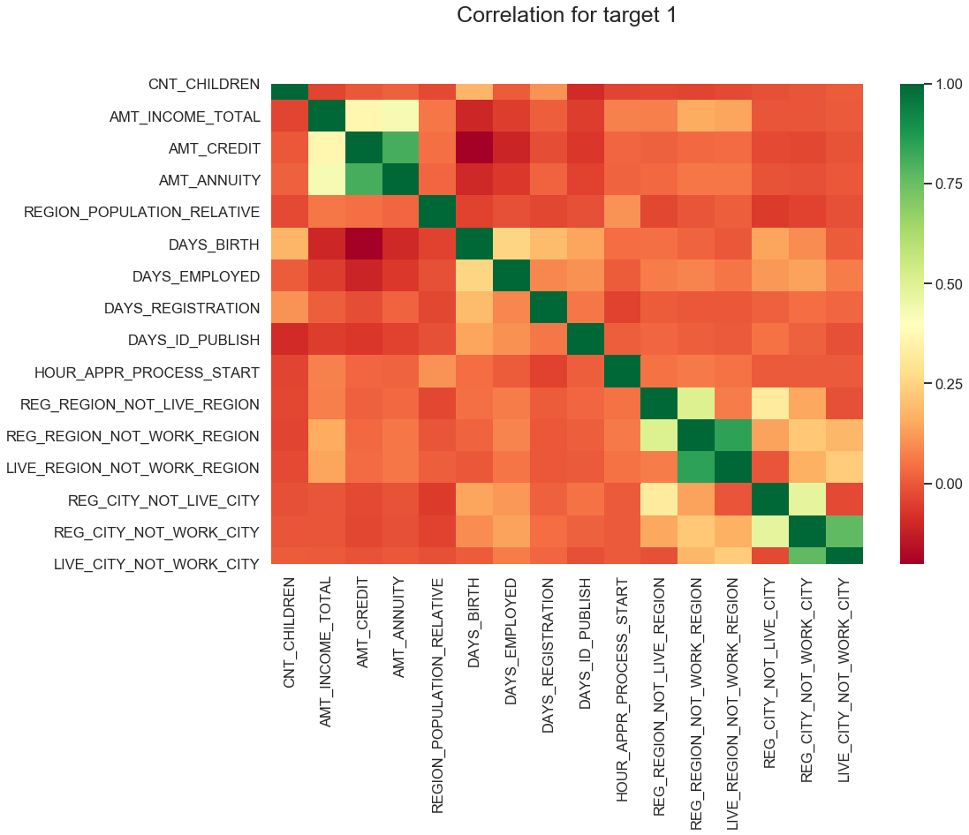
Correlation of target-1

Slide 20
Correlation of target-1
From the above correlation heat map we can conclude that :
Most of the observations are same as of target-0 correlation heat map, but few new points observed are
The client's permanent address does not match contact address are having less children and vice-versa
The client's permanent address does not match work address are having less children and vice-versa

Slide 21
Categorical Univariate analysis for variables target-0

Slide 22
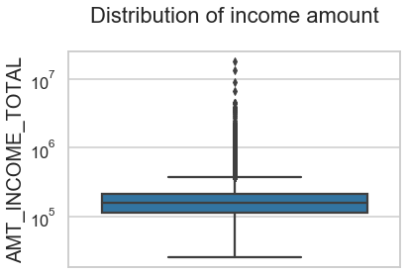
Boxplot for income amount
From the graph we can conclude that :
There are some outliers in the in the income amount column.
The third quartiles is very slim for income amount.

Slide 23
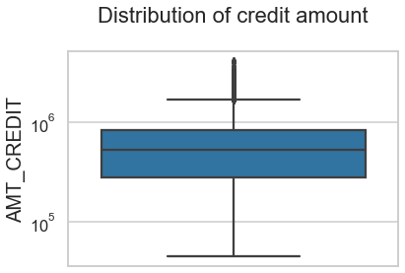
Boxplot for credit amount
From the graph we can conclude that :
The column contains some outliers.
The first quartile is bigger than third quartile for credit amount which means most of the credits of clients are present in the first quartile.

Slide 24
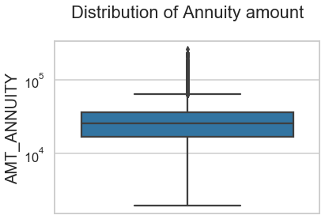
Boxplot for annuity amount
From the graph we can conclude that :
Some outliers are noticed in annuity amount.
The first quartile is bigger than third quartile for annuity amount which means most of the annuity clients are from first quartile.

Slide 25
Categorical Univariate analysis for variables target-1

Slide 26
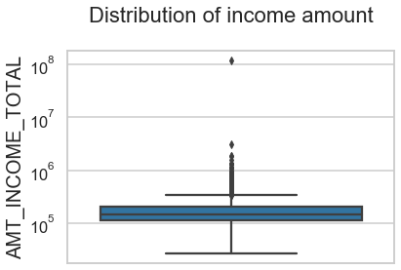
Boxplot for income amount
From the graph we can conclude that :
Some outliers are noticed in income amount.
The third quartiles is very slim for income amount.
Most of the clients of income are present in first quartile.

Slide 27
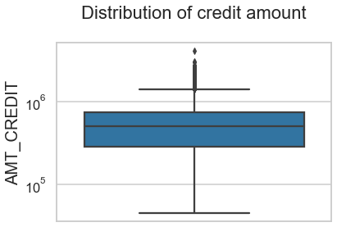
Boxplot for credit amount
From the graph we can conclude that :
Some outliers are noticed in credit amount.
The first quartile is bigger than third quartile for credit amount which means most of the credits of clients are present in the first quartile.

Slide 28
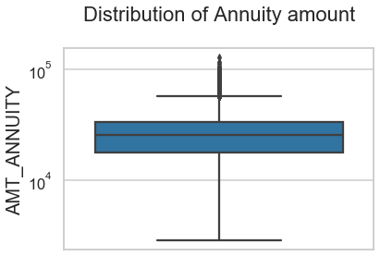
Boxplot for annuity amount
From the graph we can conclude that :
Some outliers are noticed in annuity amount.
The first quartile is bigger than third quartile for annuity amount which means most of the annuity clients are from first quartile.

Slide 29
Bivariate analysis for target-0

Slide 30
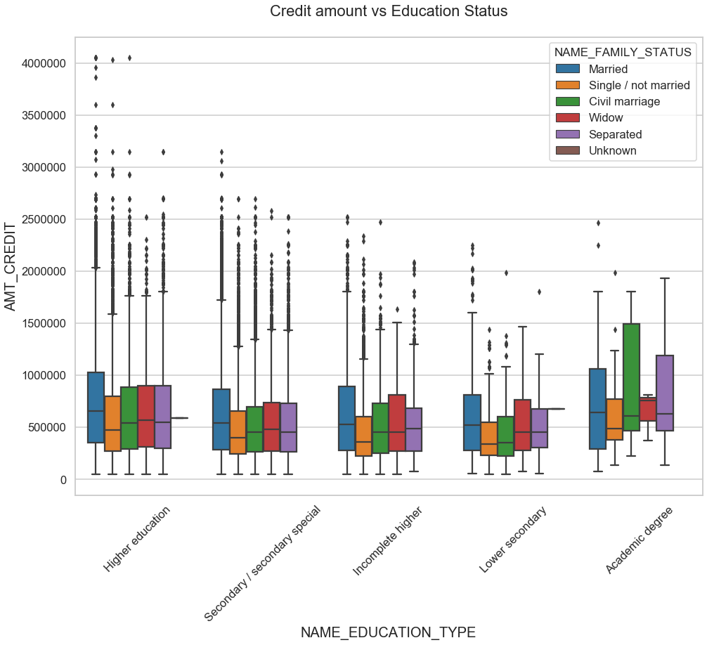
Credit amount vs Education Status
From the graph we can conclude that :
Family status of 'civil marriage', 'marriage' and 'separated' of Academic degree education are having higher number of credits than others.
Higher education of family status of 'marriage', 'single' and 'civil marriage' are having more outliers.
Civil marriage for Academic degree is having most of the credits in the third quartile.
for Academic degree section data of only married people is available and don't have any outliers.
Most outliers are from Secondary special , incomplete higher and higher education.

Slide 31
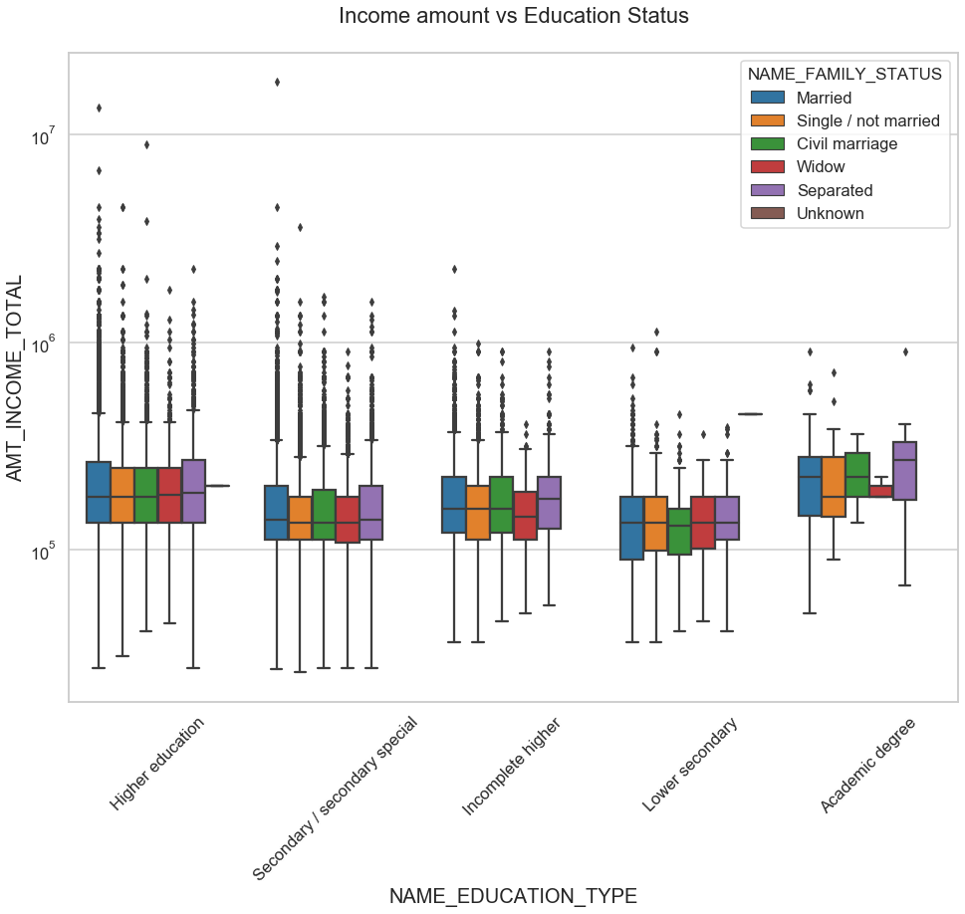
Income amount vs Education Status
From the graph we can conclude that :
For Education type 'Higher education' the income amount is mostly equal with family status. It does contain many outliers.
Less outlier are there in Academic degree but there income amount is little higher that Higher education.
Lower secondary of civil marriage family status are having" less income amount than others.

Slide 32
Bivariate analysis for target-1

Slide 33
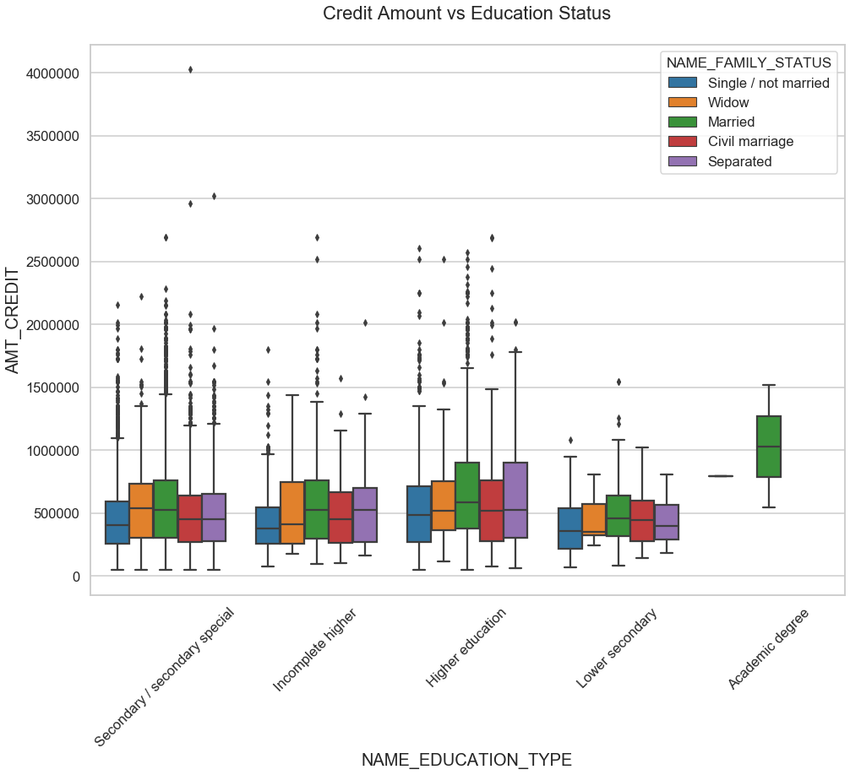
Credit amount vs Education Status
From the graph we can conclude that :
In all the section of education Status married people have taken more credits.
for Academic degree section data of only married people is available and don't have any outliers.
Most outliers are from Secondary special , incomplete higher and higher education.

Slide 34
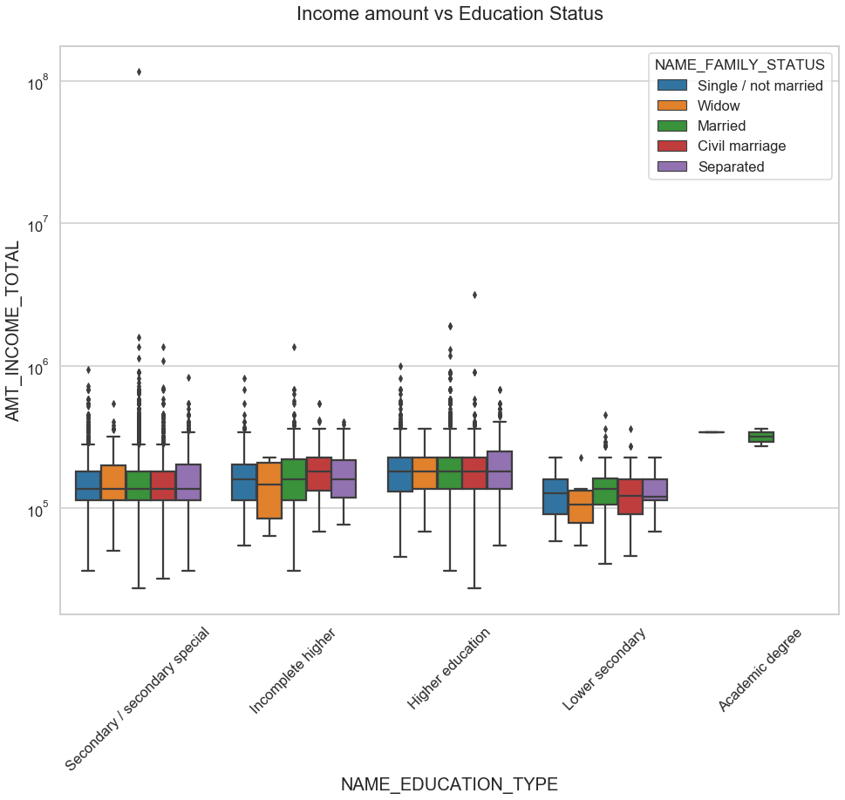
Income amount vs Education Status
From the graph we can conclude that :
Married Category is having more number of outliers in all the education categories and having more vlues in the first quartile.
Lower secondary have less income amount than others.

Slide 35
Previous Application Data
Previous application data frame is created using file previous_application.csv.
Shape, info, columns were checked.
Missing values for each columns were checked. Columns with more than 30% missing values were removed as they won’t be of any use.
Columns containing values like ‘XNA’, ‘XAP’ were dropped.
A new data frame is created by combining the application_data and previous_application data.
Columns were renamed and unwanted columns were dropped.

Slide 36
Univariate analysis after merging previous data

Slide 37
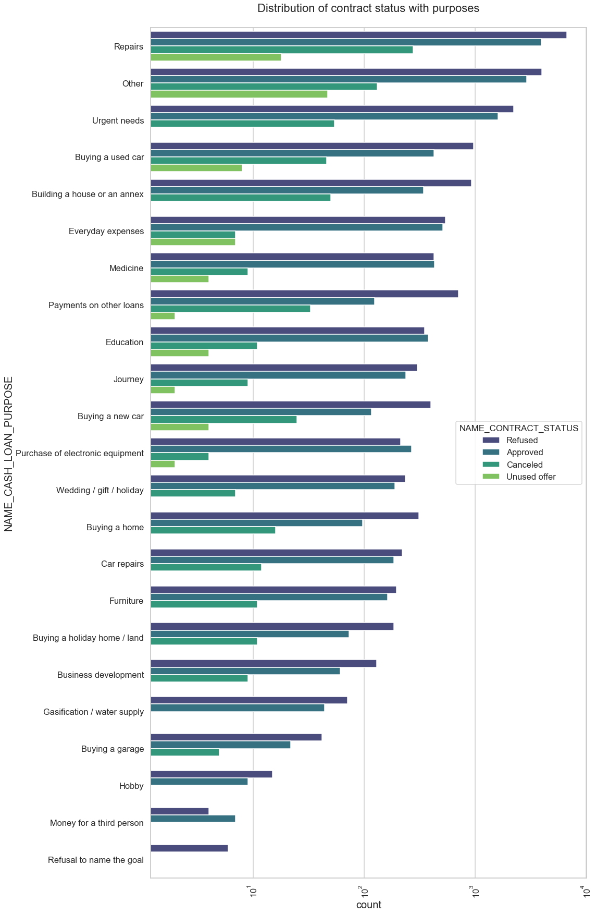
Distribution of contract status with purposes
From the graph we can conclude that :
Most rejection of loans came from purpose 'repairs'.
For Medicine purposes we have equal number of approves and rejection.
'Payments on other loans', 'buying a new car' and 'buying a home' is having significant higher rejection than approves.
only 'Money for a third person', 'Purchase of electronic equipment' and 'Education' is having more loan approval than rejections.

Slide 38
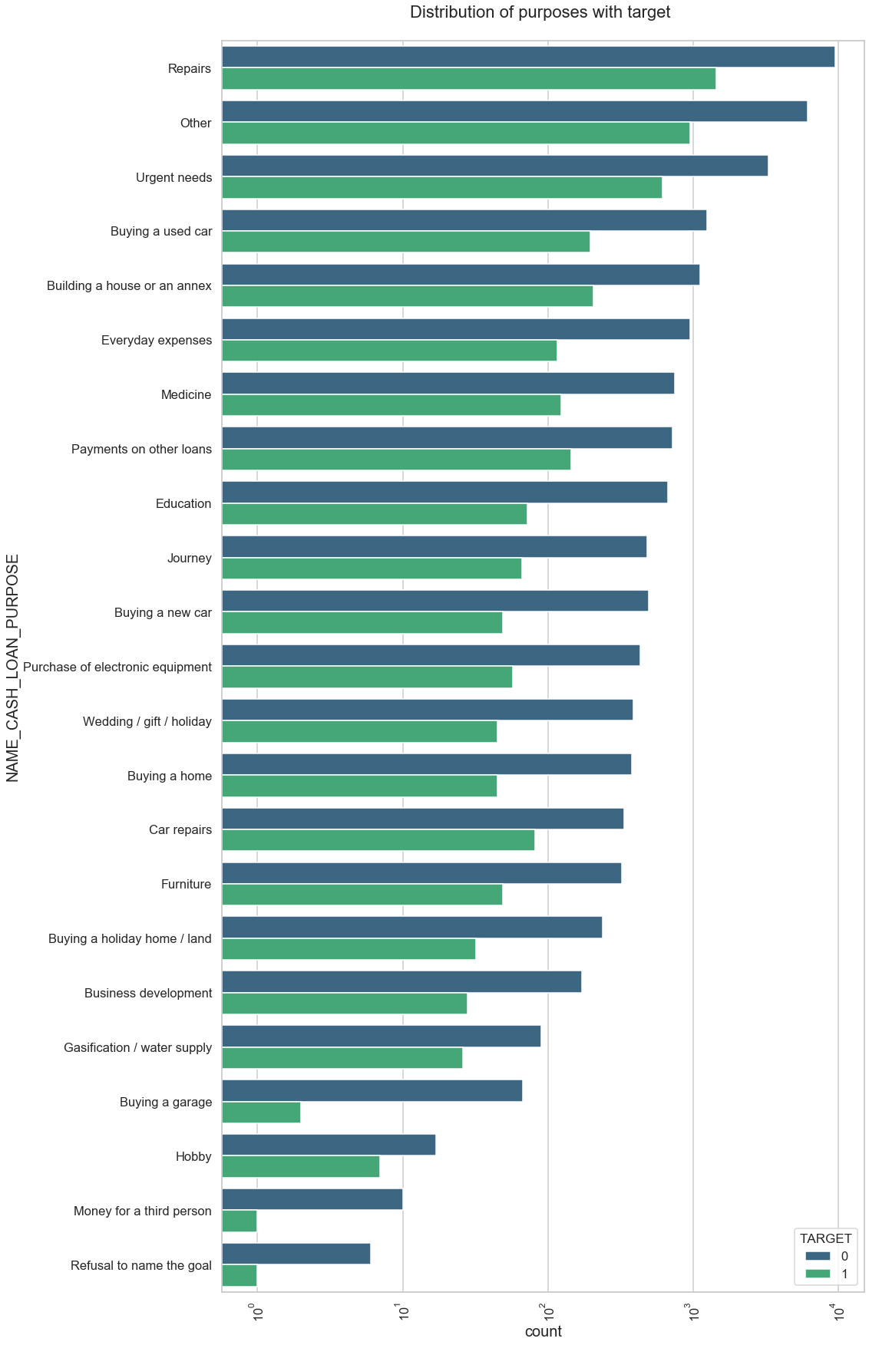
Distribution of purposes with target
From the graph we can conclude that :
Loan purposes with 'Repairs' are facing more difficulites in payment on time.
There are few places where loan payment is significant higher than facing difficulties. They are 'Refusal to the name goal','Money for a thir person', 'Buying a garage'. Hence we can focus on these purposes for which the client is having minimal payment difficulties.

Slide 39
Performing bivariate analysis

Slide 40
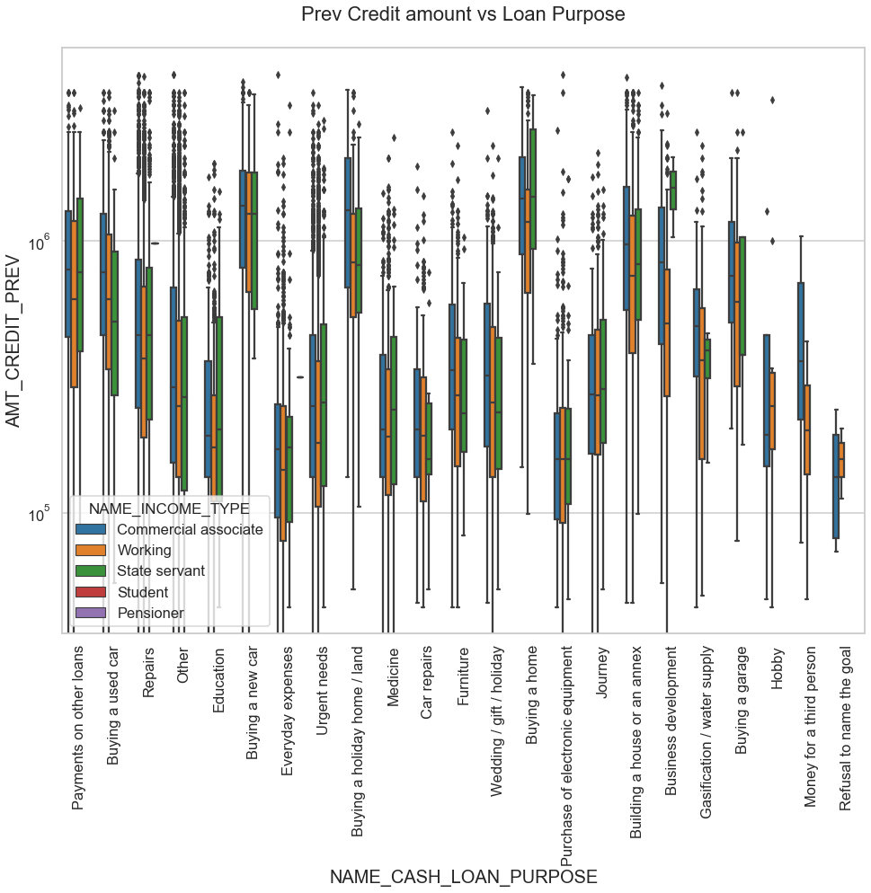

Slide 41
Prev Credit amount vs Loan Purpose
From the above graph we can conclude that
The credit amount of Loan purposes like 'Buying a home', 'Buying a land', 'Buying a new car' and 'Building a house' is higher.
Income type of state servants have a significant amount of credit applied
'Puchase of electronic equipment', 'Hobby', 'Refusal to the name the goal', 'Everyday expenses' is having less credits applied for.

Slide 42
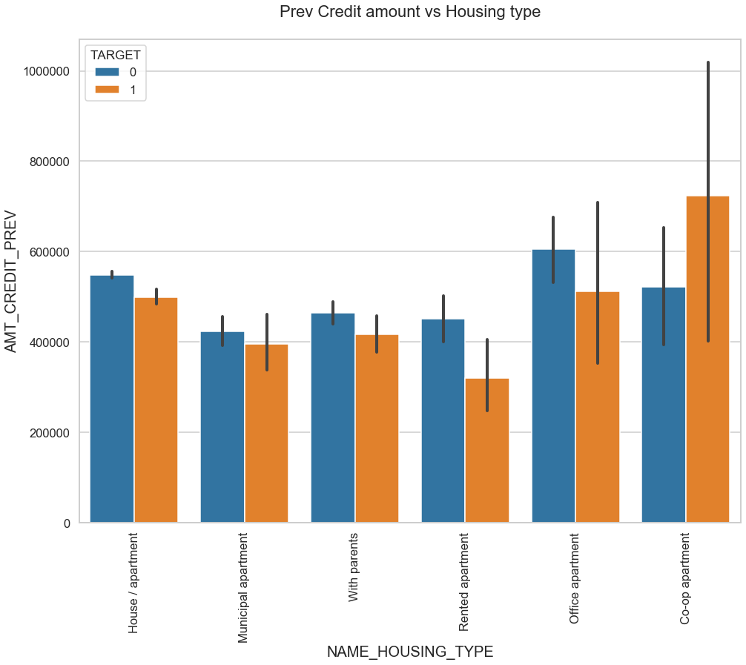
Prev Credit amount vs Housing type
From the graph we can conclude that :
For Housing type, office apartment is having higher credit of target 0.
co-op apartment is having higher credit of target 1.
So, we can conclude that bank should avoid giving loans to the housing type of co-op apartment as they are having difficulties in payment.
Bank can focus mostly on housing type with parents or House\apartment or municipal apartment or office apartments for successful payments.

Slide 43
CONCLUSION :
Banks should focus more on contract type ‘Student’ ,’pensioner’ and ‘Businessman’ with housing ‘type other than ‘Co-op apartment’ for successful payments.
Its rare an applicant prefers loan who belong to high salary category and there are no repayment issues for these applicants.
Banks should focus less on income type ‘Working’ as they are having most number of unsuccessful payments.
Also with loan purpose ‘Repair’ is having higher number of unsuccessful payments on time.
Get as much as clients from housing type ‘With parents’ as they are having least number of unsuccessful payments.

Slide 44
THANK YOU

